Slide 1
Возможности CSS3

Slide 2
Рамка из картинки (border-image)
#round {
-webkit-border-image: url(border.png) 30 30 round; /* Safari 3.1-5 */
-o-border-image: url(border.png) 30 30 round; /* Opera 11-12.1 */
border-image: url(border.png) 30 30 round;
}
#stretch {
-webkit-border-image: url(border.png) 30 30 stretch; /* Safari 3.1-5 */
-o-border-image: url(border.png) 30 30 stretch; /* Opera 11-12.1 */
border-image: url(border.png) 30 30 stretch;
}
Пример

Slide 3
Столбцы (column-count:)
.newspaper {
-webkit-column-count: 3; /* Chrome, Safari, Opera */
-moz-column-count: 3; /* Firefox */
column-count: 3;
}
Пример

Slide 4
Тень текста(text-shadow:)
h1 {
text-shadow: 5px 5px 5px #FF0000;
}
Пример

Slide 5
Перенос текста(word-wrap:)
p.test {
width: 11em;
border: 1px solid #000000;
word-wrap: break-word;
}
Пример

Slide 6
Фоны

Slide 7
Размер фона в % (background-size: %)
body {
background: url(images/camomile.png);
background-size: 100% 100%;
background-repeat: no-repeat;
}
Пример

Slide 8
Размер фона в px (background-size: px)
body {
background: url(images/camomile.png);
background-size: 80px 80px;
background-repeat: no-repeat;
padding-top: 40px;
}
Пример

Slide 9
Несколько фонов
body {
background: url(images/6.png), url(images/Logo_The_Simpsons.png);
background-size: 100% 100%;
background-repeat: no-repeat;
}
Пример

Slide 10
Позиционирование фона
(background-origin:)
div {
border: 1px solid black;
padding: 35px;
background-image: url('images/1.gif');
background-repeat: no-repeat;
background-position: left;
}
border-box
padding-box
content-box
Пример

Slide 11
Геометрия

Slide 12
Матрица преобразовании
transform: matrix(a, c, b, d, tx, ty)
Пример

Slide 13
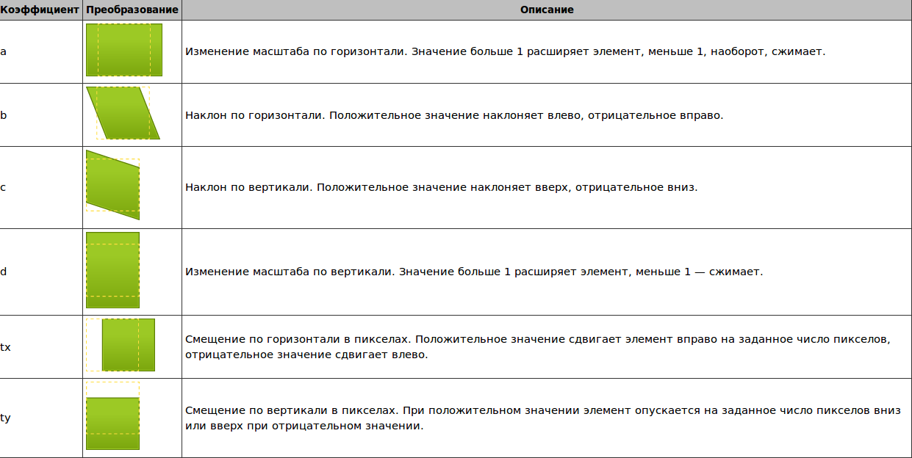

Slide 14
Поворот(transform: rotate(30deg))
div {
width: 200px;
height: 100px;
background-color: yellow;
/* Rotate div */
-ms-transform: rotate(30deg); /* IE 9 */
-webkit-transform: rotate(30deg); /* Chrome, Safari, Opera */
transform: rotate(30deg); /* Standard syntax */
}
Пример

Slide 15
Наклон(transform: skew)
div {
width: 100px;
height: 75px;
background-color: red;
border: 1px solid black;
}
div#div2 {
-ms-transform: skew(30deg,20deg); /* IE 9 */
-webkit-transform: skew(30deg,20deg); /* Chrome, Safari, Opera */
transform: skew(30deg,20deg); /* Standard syntax */
}
Пример

Slide 16
Перемещение(transform: translate)
div {
width: 100px;
height: 75px;
background-color: red;
border: 1px solid black;
}
div#div2 {
-ms-transform: translate(50px,100px); /* IE 9 */
-webkit-transform: translate(50px,100px); /* Chrome, Safari, Opera */
transform: translate(50px,100px); /* Standard syntax */
}
Пример

Slide 17
Градиентный фон

Slide 18
Линейный градиент сверху вниз
Пример
#grad1 {
height: 200px;
background: -webkit-linear-gradient(green, gold); /* For Safari 5.1 to 6.0 */
background: -o-linear-gradient(green, gold); /* For Opera 11.1 to 12.0 */
background: -moz-linear-gradient(green, gold); /* For Firefox 3.6 to 15 */
background: linear-gradient(green, gold); /* Standard syntax (must be last) */
}

Slide 19
Линейные градиенты под различными углами
Пример
#grad1 {
height: 100px;
background: -webkit-linear-gradient(0deg, greenyellow, green); /* For Safari 5.1 to 6.0 */
background: -o-linear-gradient(0deg, greenyellow, green); /* For Opera 11.1 to 12.0 */
background: -moz-linear-gradient(0deg, greenyellow, green); /* For Firefox 3.6 to 15 */
background: linear-gradient(0deg, greenyellow, green); /* Standard syntax (must be last) */
}

Slide 20
Градиент по диагонали
#grad1 {
height: 200px;
background: -webkit-linear-gradient(left top, Highlight , greenyellow); /* For Safari 5.1 to 6.0 */
background: -o-linear-gradient(bottom right, Highlight, greenyellow); /* For Opera 11.1 to 12.0 */
background: -moz-linear-gradient(bottom right, Highlight, greenyellow); /* For Firefox 3.6 to 15 */
background: linear-gradient(to bottom right, Highlight , greenyellow); /* Standard syntax (must be last) */
}
Пример

Slide 21
Линейный градиент слева напрово
Пример
#grad1 {
height: 200px;
background: -webkit-linear-gradient(left, Highlight , greenyellow); /* For Safari 5.1 to 6.0 */
background: -o-linear-gradient(right, Highlight, greenyellow); /* For Opera 11.1 to 12.0 */
background: -moz-linear-gradient(right, Highlight, greenyellow); /* For Firefox 3.6 to 15 */
background: linear-gradient(to right, Highlight , greenyellow); /* Standard syntax (must be last) */
}

Slide 22
Плавный переход
#grad2 {
height: 200px;
background: -webkit-linear-gradient(red, orange, yellow, green, blue, indigo, violet); /* For Safari 5.1 to 6.0 */
background: -o-linear-gradient(red, orange, yellow, green, blue, indigo, violet); /* For Opera 11.1 to 12.0 */
background: -moz-linear-gradient(red, orange, yellow, green, blue, indigo, violet); /* For Firefox 3.6 to 15 */
background: linear-gradient(red, orange, yellow, green, blue, indigo, violet); /* Standard syntax (must be last) */
}
Пример

Slide 23
Линейный градиент сверху вниз
Пример
#grad1 {
height: 200px;
background: -webkit-linear-gradient(green, gold); /* For Safari 5.1 to 6.0 */
background: -o-linear-gradient(green, gold); /* For Opera 11.1 to 12.0 */
background: -moz-linear-gradient(green, gold); /* For Firefox 3.6 to 15 */
background: linear-gradient(green, gold); /* Standard syntax (must be last) */
}

Slide 24
Радиальный градиент(%)
#grad1 {
height: 150px;
width: 200px;
background: -webkit-repeating-radial-gradient(gold, lightblue 10%, green 15%); /* For Safari 5.1 to 6.0 */
background: -o-repeating-radial-gradient(gold, lightblue 10%, green 15%); /* For Opera 11.6 to 12.0 */
background: -moz-repeating-radial-gradient(gold, lightblue 10%, green 15%); /* For Firefox 3.6 to 15 */
background: repeating-radial-gradient(gold, lightblue 10%, green 15%); /* Standard syntax (must be last) */
}
Пример

Slide 25
Радиальный градиент(переход)
#grad1 {
height: 150px;
width: 200px;
background: -webkit-radial-gradient(gold 5%, lightblue 15%, green 60%); /* Safari 5.1 to 6.0 */
background: -o-radial-gradient(gold 5%, lightblue 15%, green 60%); /* For Opera 11.6 to 12.0 */
background: -moz-radial-gradient(gold 5%, lightblue 15%, green 60%); /* For Firefox 3.6 to 15 */
background: radial-gradient(gold 5%, lightblue 15%, green 60%); /* Standard syntax (must be last) */
}
Пример

Slide 26
Радиальный градиент
#grad1 {
height: 150px;
width: 200px;
background: -webkit-radial-gradient(gold, lightblue, green); /* Safari 5.1 to 6.0 */
background: -o-radial-gradient(gold, lightblue, green); /* For Opera 11.6 to 12.0 */
background: -moz-radial-gradient(gold, lightblue, green); /* For Firefox 3.6 to 15 */
background: radial-gradient(gold, lightblue, green); /* Standard syntax (must be last) */
}
Пример

Slide 27
Анимация

Slide 28
Создание анимации (animation: myfirst)
div {
width: 100px;
height: 100px;
background: blue;
-webkit-animation: myfirst 5s; /* Chrome, Safari,Opera
animation: myfirst 5s;
}
/* Chrome, Safari, Opera */
@-webkit-keyframes myfirst {
from {background: blue;}
to {background: yellow;}
}
/* Standard syntax */
@keyframes myfirst {
from {background: blue;}
to {background: yellow;}
}
Пример

Slide 29
transition()
div {
width: 100px;
height: 100px;
background: lightblue;
-webkit-transition: width 3s; /* For Safari 3.1 to 6.0 */
transition: width 3s;
}
div:hover {
width: 400px;
}
Пример

Slide 30
Сложная анимация(transform и transition)
div {
width: 140px;
height: 100px;
background: gold;
-webkit-transition: width 2s, height 2s, -webkit-transform 2s; /* For Safari 3.1 to 6.0 */
transition: width 2s, height 2s, transform 2s;
}
div:hover {
width: 200px;
height: 200px;
-webkit-transform: rotate(180deg); /* Chrome, Safari, Opera */
transform: rotate(180deg);
}
Пример

